Slide 1
Advocacy to end AIDS
Vuyiseka Dubula
On behalf of Fight AIDS Coalition (FAC)
Centre for Civil Society (the University of Kwazulu-Natal)

Slide 2
Who is Fighting AIDs Coalition
Any person living with HIV concerned about the ongoing AIDS related deaths
PLHIV networks
Civil Society organisations
Academics
Public servants

Slide 3
WHY DO WE NEED COLLECTIve ACTION?
AIDS = death sentence to some!
Dead PLHIV cannot speak!
OUR Silence is deadly
Picture Source: MSF

Slide 4
WHAT to do?
Pressure the global institutions to end AIDS invisibility and deaths
Pressure global institutions to prioritize ending AIDS - political will
Donor community to prioritize ending AIDS/AHD and fund it
Pressure industry for greater access to affordable diagnostics and treatment
Civil society act to visibilise AIDS deaths and hold govts accountable
Movement building !!! – build grassroots power and global solidarity

Slide 5
GLOBAL INSTITUTIONS: unaids & who
WHO
Endorsement “Framework to End CM Deaths by 2030”
We want a section in the new Strategy on HIV, that commits to Developing an End Crypto Strategy By December 2021
WHO to provides Technical Assistance to countries to update their guidelines on AIDS diagnostics, and treatment
WHO and UNAIDS develop recommendations for countries’ National Strategic Plans (NSPs)
WHO mobilizes resources and political will
UNAIDS
Push for UNAIDS statements to name AIDS deaths, i.e cryptococcal meningitis and TB biggest killers of PLWHA
UNAIDS to endorse “Framework to End CM Deaths by 2030”
UNAIDS Prioritises in its Political Advocacy Agenda AIDS
Uses its leverage to mobilise GFATM & PEPFAR
Notes:
2. or develops something it will endorse and measure and work toward

Slide 6
DONOR COMMUNITY
PEPFAR
Activists to meet PEPFAR
AIDS deaths and incidence as a priority in new PEPFAR Strategy.
COP22 Guidance -maintain priority language on AIDS.
Clear language and budgets on CD4, TB-LAM, CrAG, L-Amb, Flucytosine.
Leverage PEPFARs AIDS commodities gap with Global FUND
Add cryptococcal meningitis (incidents, deaths) among the dataset/ indicators and provide reports
CD4 baseline test for PLHIV as a core element in the HIV package of care
GLOBAL FUND
The strategy - include ending AIDS and funds AIDS Diagnostics, and treatment therapies and models of care that prevent AIDS
CCM members to push for language inclusion language on ending AIDS in Mid-term reviews of NSP
CCMs funding requests (beyond 2022) includes the AIDS package of diagnostics and drugs (CD4, TB-LAM, CrAG, L-Amb, Flucytosine) as priorities and allocates sufficient funding for these
Notes:
3. Maintains AIDS as a minimum requirement ( priority list of PEPFARs recommended

Slide 7
GLOBAL INSTITUTIONS: unitaid
Continue AIDS/AHD funding beyond 2022.
Prioritise AIDS/AHD in your next Strategy.

Slide 8
governments
Provision of AIDS diagnostics and treatment (CD4, TB-LAM, CrAG, L-Amb, Flucytosine in PHC and HIV services
Measuring cryptococcal meningitis incidents and deaths
Targets to reduce cryptococcal meningitis deaths within 3-5 years
PRIMARY HEALTH CARE LEVEL
TB-LAM included in national guidelines and providing TB-LAM at PHC
Increased use of TB-LAM at hospital and clinics
Bring back CD4 is mainstreaming as a core element in the HIV package of care
Make CrAg available
Make CM prevention and treatment available at the PHC level
Registration
Countries to register drugs to treat cryptococcal meningitis (L-Amb, Flucytosine)
Governments remove registration barriers
Gilead submit registration dossiers to all high burden regions for L-Amb

Slide 9
INDUSTRY
Gilead: fulfils its commitment to lower prices for liposomal amphotericin B (L-AmB) for 116 countries by June 2022?
Rifapentine pricing and access issues are addressed
Mylan: Availability of generic flucytosine
Qualified generic versions of liposomal amphotericin B (L-AmB)
Explore impact and manufacturing of Visitec CD4 POC

Slide 10
MOVEMENT BUILDING
CS collect data and our stories and report on AIDS tools
CSOs in all regions to include AIDS indicators as part of their community led monitoring, including whether critical tools and services are available
Advocates for clear asks in the PEPFAR COPs FY2022
Treatment Literacy
Consolidate activist toolkit on AIDS (prevention, diagnosis, treatment and support
Webinars and trainings to be conducted to equip and mobilise communities to effectively lobby for AIDS across all regions.

Slide 11
MOVEMENT BUILDING…CONT
Activists checklist tools for available services (diagnostics, prevent, treat AIDS in FR/ENG is updated by MSF
AIDS Campaign Tools (digital, social, messaging etc) developed for CSOs and communities
Develop country specific 3-5 contextualised fact sheets
Collaboration with clinicians in and CSOs.

Slide 12
DON’T PLAN TO MOURN , ORGANISE TO SAVE LIVES
LETS TAKE BACK WORLD AIDS TO NAME THE INVISIBLE KILLER OF PEOPLE LIVING WITH HIV
JOIN OUR GLOBAL CALL FOR ACTION – In SA contact me or Sibongile on how can we include your org in the coalition
Identify : Key moments in 2021/22

Slide 13
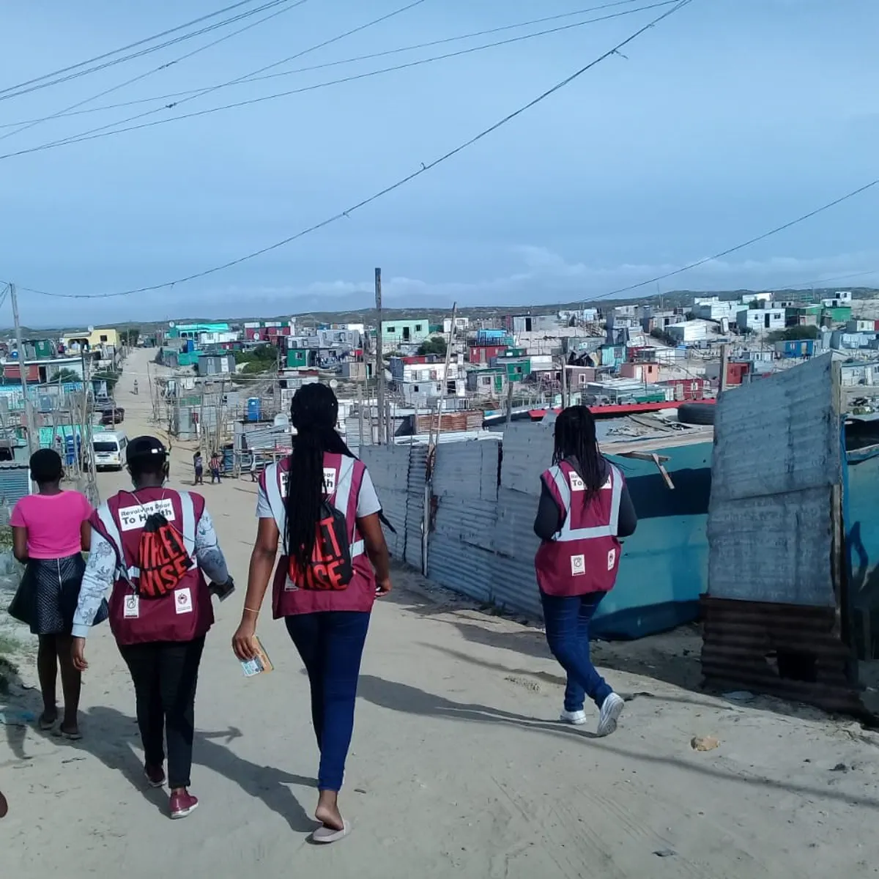

Slide 14
Forward we go, backward never! Amandla!

